Slide 1
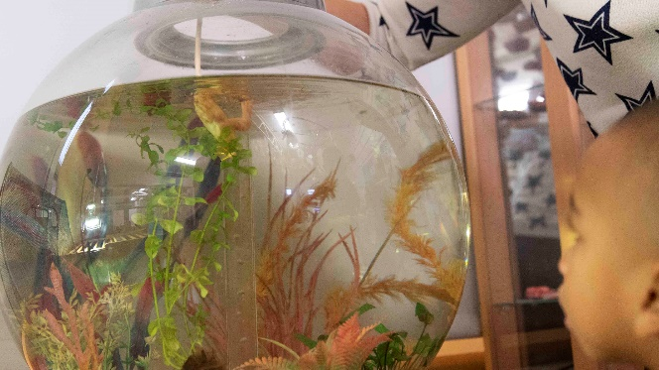
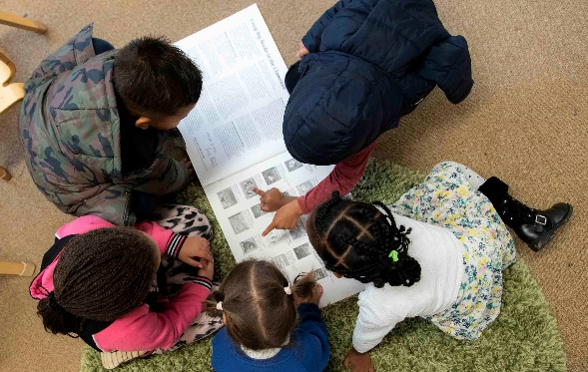
What can I expect from if my child has Special Educational Needs?
We will make sure your child is safe and happy
Have open and honest communication
Appropriate and effective teaching and learning
A Partnership Approach

Slide 2
Definition of Special Educational Needs
Children have special educational needs if they have a learning difficulty which calls for special educational provision to be made for them.
Children have a learning difficulty if they:
a) Have a significantly greater difficulty in learning than the majority of children of the same age
b) Have a disability which prevents, or hinders them from making use of educational facilities of a kind generally provided for children of the same age in schools within the area of the local education authority
c) Are under compulsory school age and fall within the definition at (a) or (b) above or would so do if special educational provision was not made for them.
SEN CoP 1:3

Slide 3
What should I do if I have concerns about my child?
What will happen if the nursery have concerns about my child?
If you have any concerns speak to your child’s keyworker, or make an appointment to see the SENCO. Our SENCo is Tamar Cohen. If we have any concerns we will speak to you as soon as possible.
The SENCO and Keyworker will assess your child’s needs through a range of strategies
Once your child’s individual needs have been identified the SENCO may need to contact specialised services - these can include Speech and Language therapists, The Communication and Autism Team, or an Educational Psychologist. We will always ask for your permission first.
The SENCO and the nursery team will monitor your child’s progress and will meet with you regularly to discuss how your child is getting on.
You will be kept fully informed of all the support your child is receiving and you will be involved at every stage of the process.
Together with the SENCO and any specialised services, you will contribute to agreeing targets that will support your child’s needs.

Slide 4
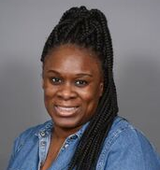
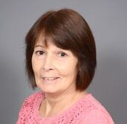
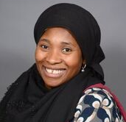
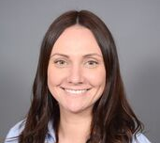
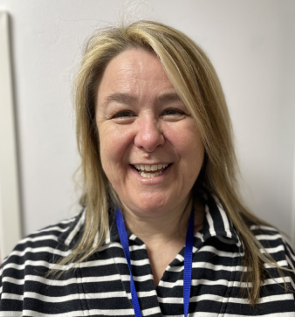
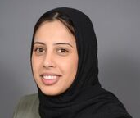
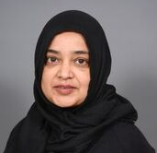
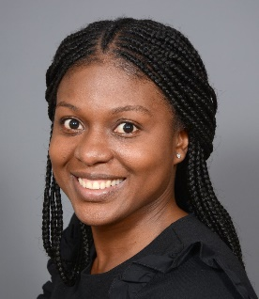
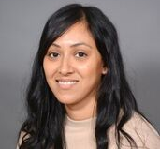
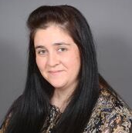
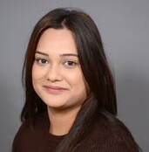
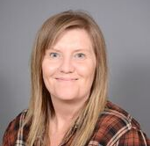
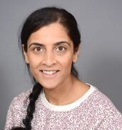
Our Team….
All of the staff at Bloomsbury Nursery School have received training to support children with a range of needs. Your child’s keyworker is able to answer many questions, provide support and identify pathways with parents. The SENCo, will work with parents and keyworkers as a team.
Tamar Cohen
SENCo

Slide 5
Appropriate and effective personalised teaching and learning
At Bloomsbury Nursery School we are committed to supporting every child. To ensure we can do this effectively our team members attend a wide range of training and regularly seek advice from outside agencies and professionals in other settings.
The training that the nursery team receive is based on the individual needs of the children who attend. The SENCO, with the support of the Headteacher and Governors, ensures that training is up to date and is appropriate.
All of our educators are trained to use Makaton to support communication.

Slide 6
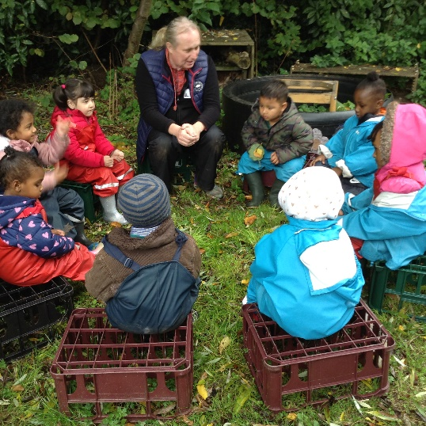
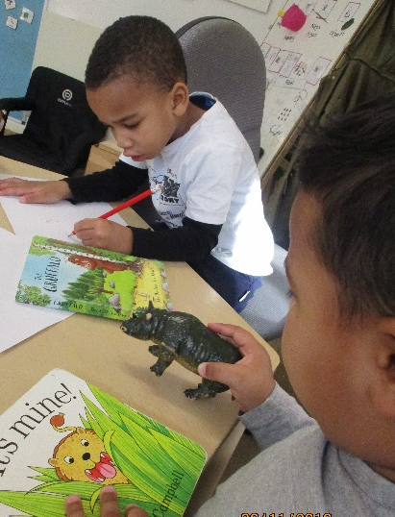
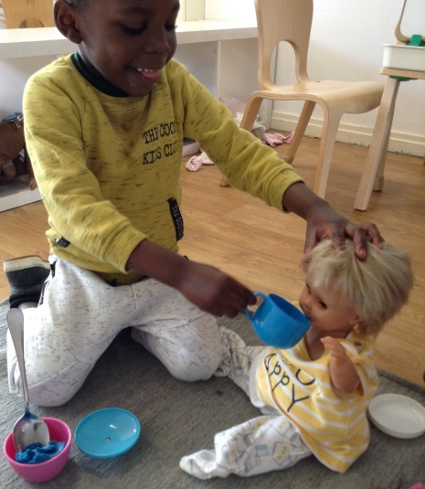
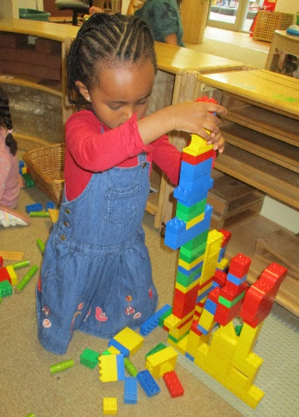
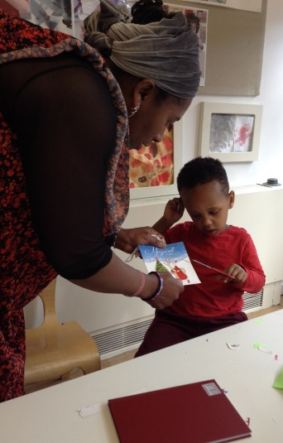
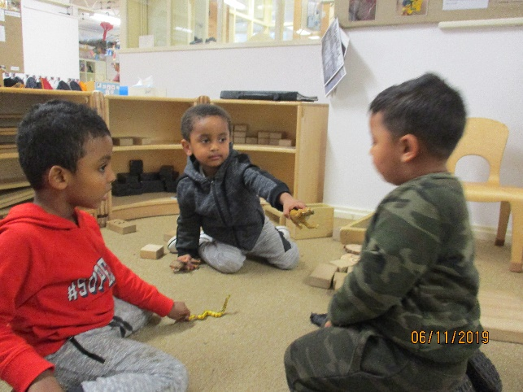
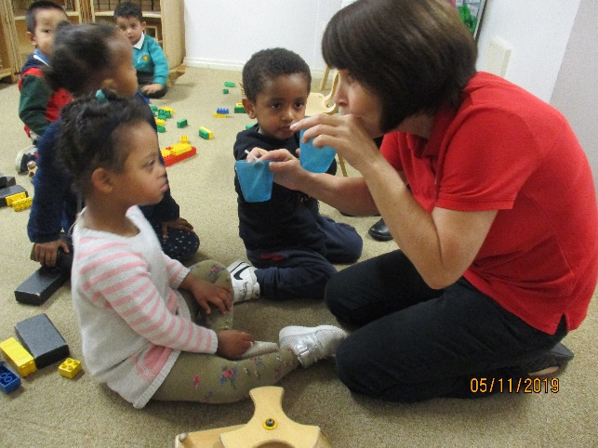
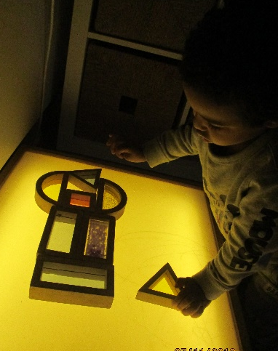
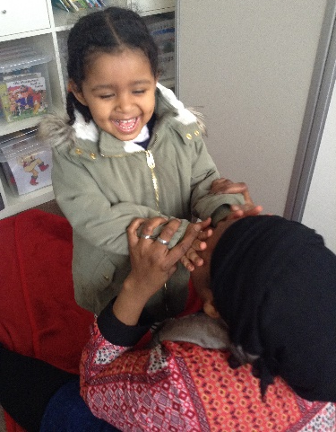
Before any intervention, we ensure that we have given the children time to settle, feel safe and happy, and build positive relationships. We spend time Getting To Know each child.
Stand aside for a while and leave room for learning, observe carefully what children do, and then, if you have understood well, perhaps teaching will be different from before.
Loris Malaguzzi

Slide 7
Specialist Provision
At Bloomsbury Nursery School, we have a specialised teaching and learning environment for children with Complex and Significant needs. Children are able to attend a morning session for up to 3 hours, an afternoon session for up to 3 hours, or all day if appropriate.
Individual children’s needs are assessed and access to this provision is funded through a range of funding streams such as; Inclusion Support for Early Year (ISEY), Sen Support Provision Plan funding and Top Up Funding through the Education and Health Care Plan.
We have Early Years Educators, who support the children throughout their session, using a range of specialist teaching strategies such as:
PECS training
AET Tier 1 and 2/ 3
Makaton
Visual Aids, objects of reference, ques and individual timetables
Soft Play room/ Physical Space
Sensory Room
Sensory activities and sensory circuits
Communicate and Print
Attention Birmingham – Attention and listening interventions

Slide 8
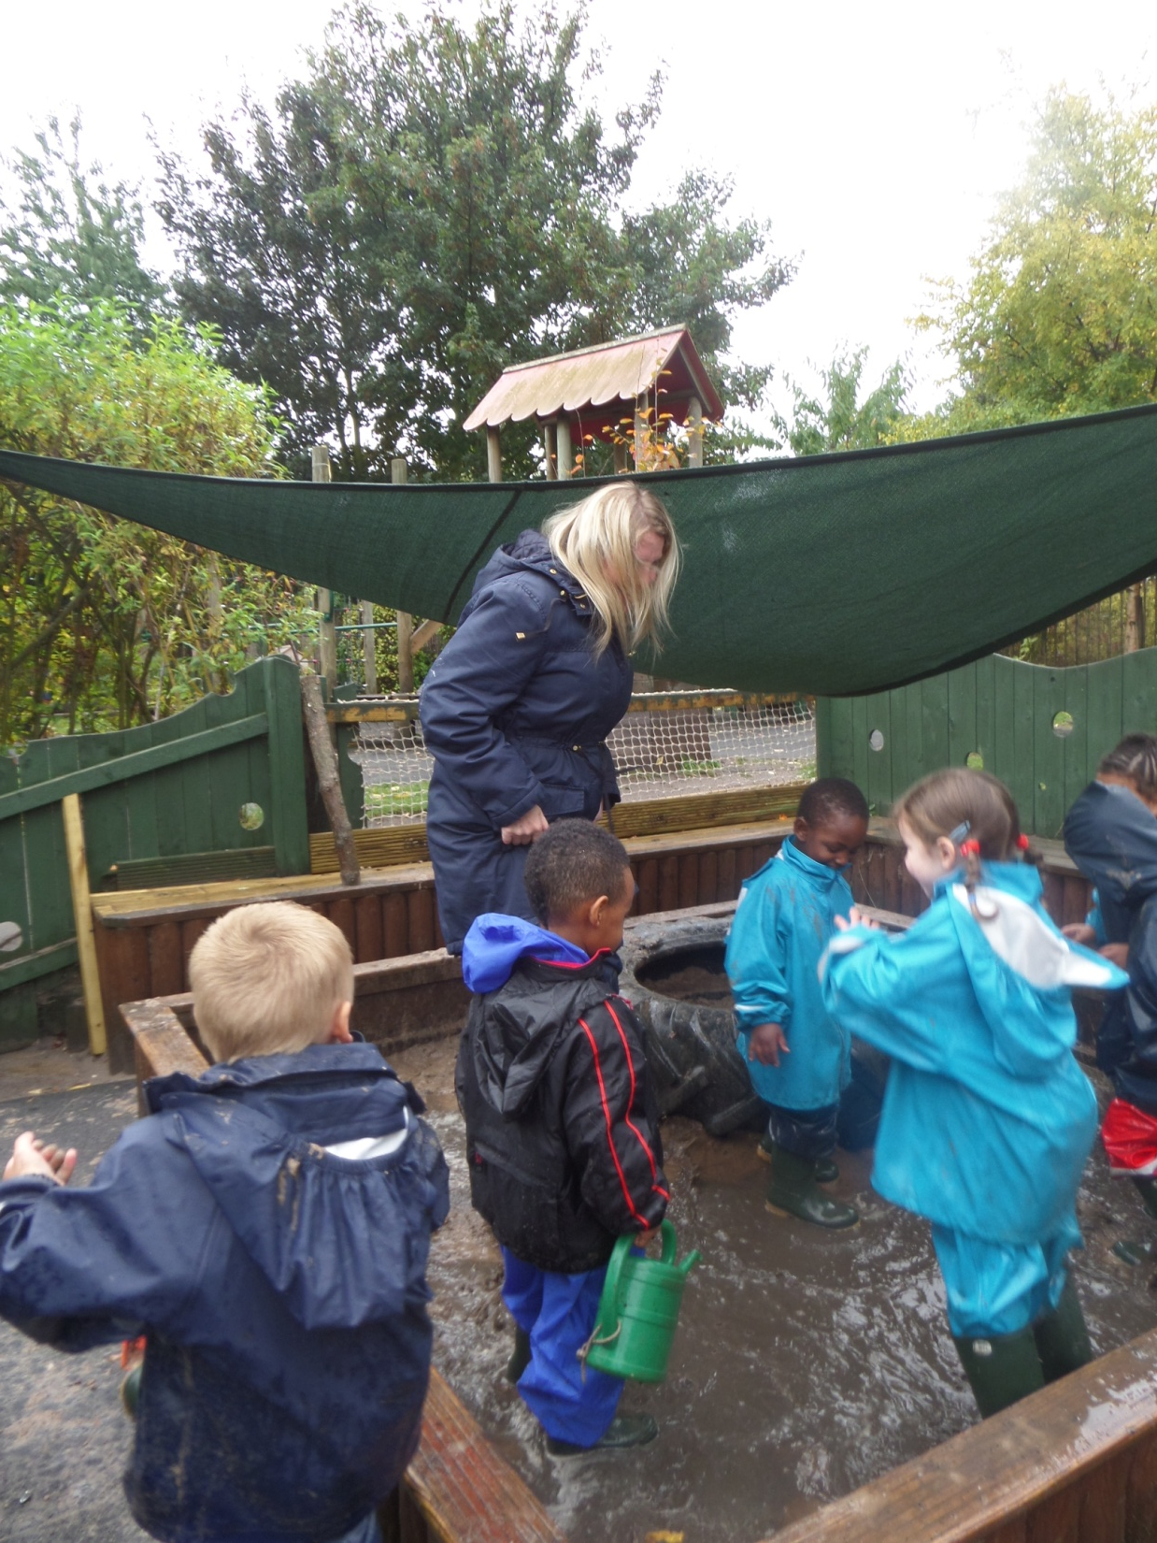
How we work
Step 1 Gather information from Parents/Carers
Home Visits/ Stay and Play at Nursery
All about Me
Step 2 Develop our knowledge of the Children
WellComm
Baseline Assessments (EYFS)
Step 3 Teaching and Learning, Targeted intervention
Continuous Provision – independent play, educator supported, visual timetables,
Targeted Support –all keyworkers have photo cards, communication boards, individual communication systems for different children
SENCO
Family Support
Educational Psychologist
CAT Team
Health Visitor
Occupational Therapy
This support is accessed at each step

Slide 9
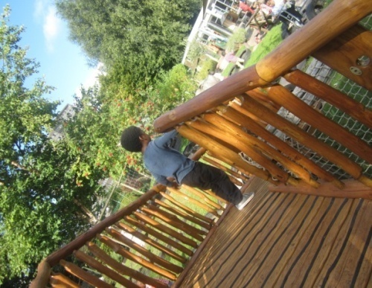
Graduated Response
Bloomsbury adopts the
Graduated Response for all children
The Graduated Approach which has Four Stages of action:
1. Assess - Bloomsbury Assessments are:
Baseline
WellComm
Tapestry – online Learning Journey
observations
2. Plan - This happens daily and weekly, in
whole staff meetings
3. Do - In a variety of ways
4. Review - monitor every 2 weeks for a 6
week period. After 6 weeks a
decision will be made whether the
child needs a SEN Support Plan and
referrals to different professionals

Slide 10
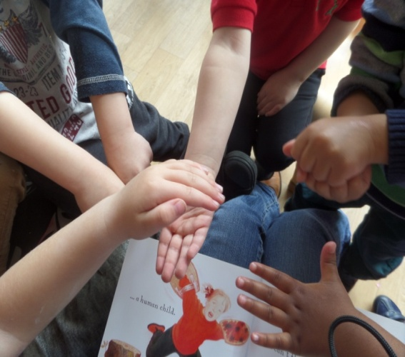
A Partnership Approach
Bloomsbury Nursery School works with outside agencies who can provide a specialised service, to ensure every child has their needs met. We will always talk to you if we feel that your child needs support from an outside agency and we will ask for your permission to involve them.
Educational Psychologist (EP)
Supports children who have social, mental or emotional needs, or other complex needs.
SENAR – Principal Officer (PO)
If your child has an Education and Health Care Plan (EHC) we will work closely with your Principal Officer.
Speech & Language Therapy Service (SALT) –Support for children with speech and language difficulties.
Communication & Autism Team (CAT) - Supports children, or young people who are being assessed for, or already have, a diagnosis of Autism or social, communication difficulties.
Occupational Therapy
Support for children or young people with physical/sensory issues which impact on their levels of independence and self care
Family Support Team
We have access to family support and the team can help you to make a referral if needed.
Health Visitor
Support for children with development checks, medical needs, including where medication is prescribed/required.

Slide 11
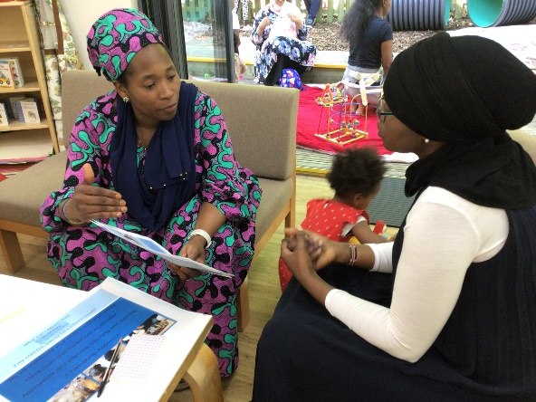
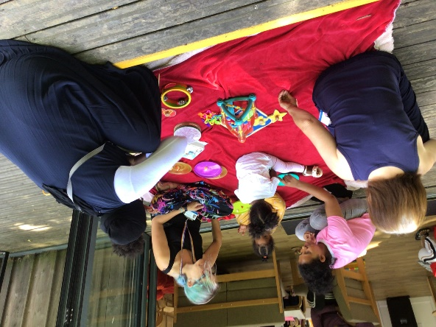
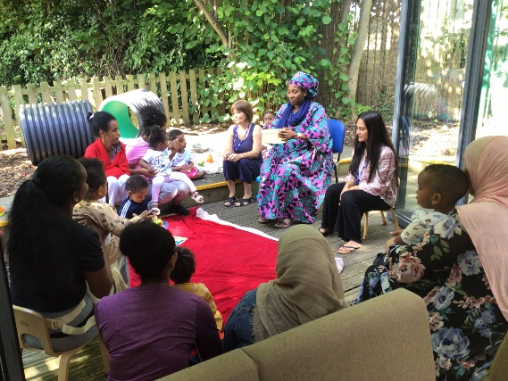
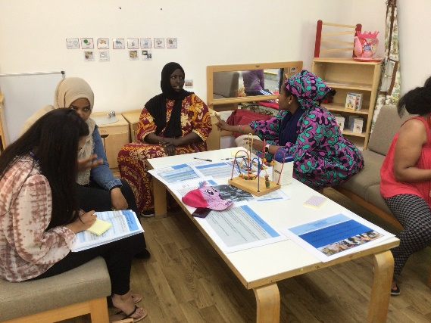
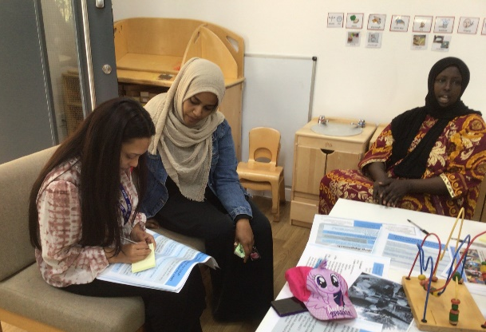
Consultation with Parents
Meeting with parents at nursery in July 2022.
SENCo and Keyworkers from both
sides of nursery – 2-4 year olds. Met
With parents and looked at the report.
They shared what has been helpful and
How to make the process clearer for
Them.

Slide 12
Comments from Parents
A parent shared that she would like reviews of her child’s progress or deterioration every 2 weeks.
“More coffee mornings with information and possibly a translator.”
One parent shared “our journey with nursery has been amazing. I have felt very included in decisions made about my child's learning. I would perhaps like a bit more of scheduled meetings (I know this can be difficult).”
“I have learnt a lot of techniques/ methods of what I know now, so maybe at the start just a workshop with do’s and don’ts etc.”
I would like to know more about how kids with different languages are supports if they don’t understand English.”
Looking and reflecting on the Information reports a parents said “I would add more pictures to understand more.”
Every child is different and has individual needs. We have parents from all backgrounds and cultures and walks of life. We should try to be alternative to each need.”

Slide 13
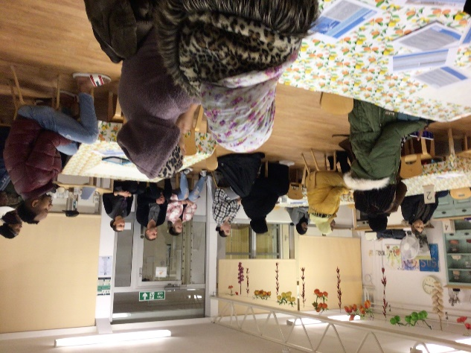
Consultation with Parents 2023
Parent Comments – Things we do well
This is the first nursery I have been invited into to speak about kids learning and playing
Extend the school
Lots of good things happening at nursery
My child enjoys Forest School and being outside
I like the open plan environment – my child can be free
My child enjoys learning through music and learning in play.
I think its good that we celebrate all of the religion's
I am happy with everything, the teachers, all the support they give to our kids – Thank you very much
I am very happy with the support I get from the school and the teachers
Thanks a lot for all you do for our kids…Thanks!

Slide 14
Parent Comments 2023
Things we can do to build on our provision for Children and Parents
I would like more ideas to help my child with handwriting
I would like to coming into nursery more, for about 10 minutes to see how my child plays and how they help her.
More face to face communication with my child’s keyworker
More communication between parents and staff and when they move classroom
More educational Trips
I would like more photos on Tapestry, to show me how to help my child
I need more support to get on Tapestry and upload what they do at home

Slide 15
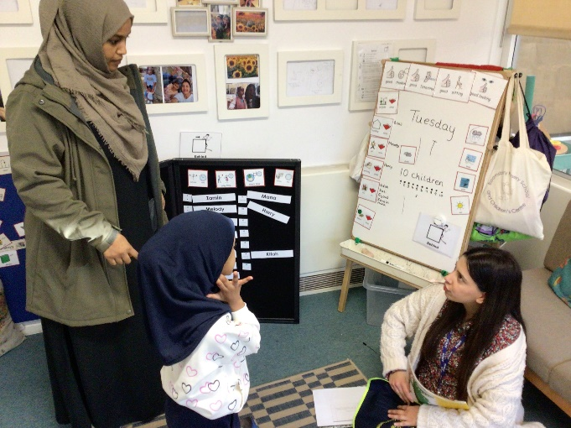
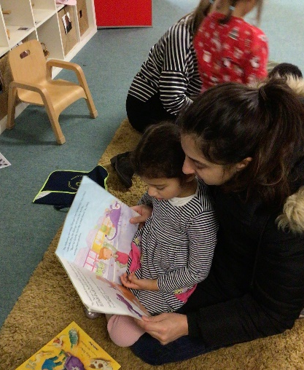
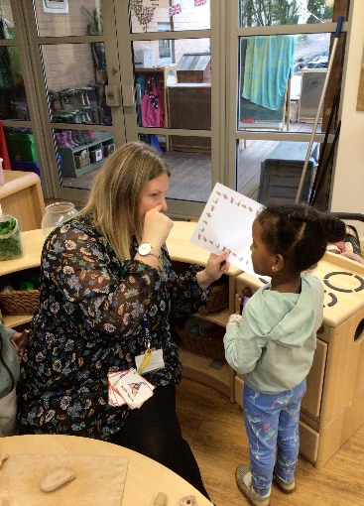
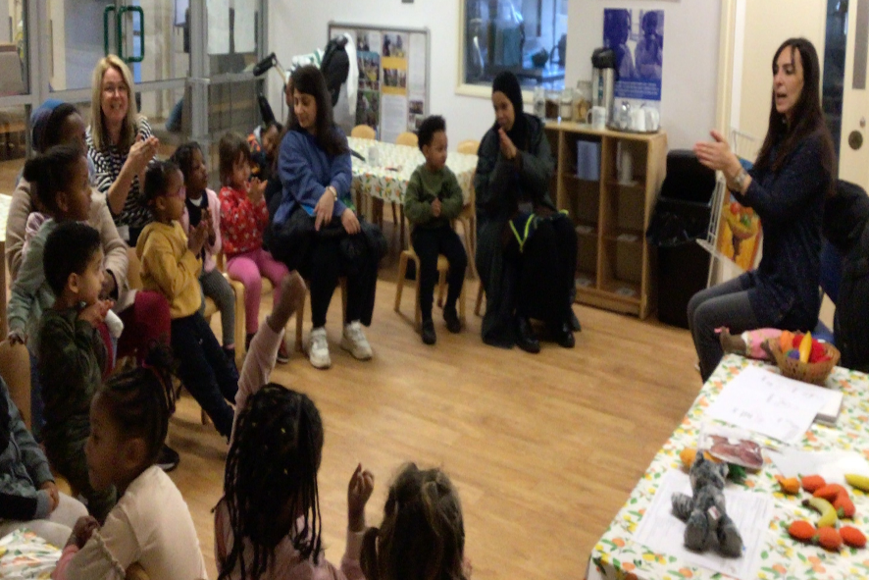
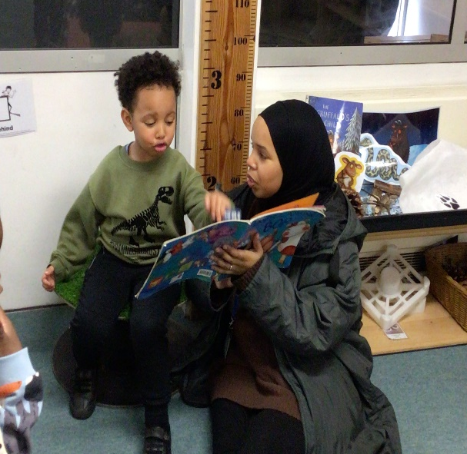
Every half term we have a parent workshop in nursery. Please check our newsletter and calendar to see what’s happening in nursery.
Communication Workshop November 2023.
Parents joined our Makaton Sign a Story session, learnt about how we teach new vocabulary and joined their child in a range of activities in the environment.
Parents also spoke to keyworkers about their child’s interests.

Slide 16
Useful Documents found on My Care in Birmingham
Local Offer – Birmingham
https://www.localofferbirmingham.co.uk/
https://birmingham.connecttosupport.org/s4s/WhereILive/Council?pageId=3859&lockLA=True
SEN Code of Practice
https://www.birmingham.gov.uk/info/50034/birminghams_local_offer_send/1421/special_educational_needs_code_of_practice
https://assets.publishing.service.gov.uk/government/uploads/system/uploads/attachment_data/file/398815/SEND_Code_of_Practice_January_2015.pdf
EHC pathway
https://www.birmingham.gov.uk/downloads/file/8190/ehc_pathway_revised_130815

